Slide 1
Controller Architectures for Optimum Performance in Practical Active Acoustic Metamaterials
M. Reynolds, S. Daley, Y. Gao, V. Humphrey, S. A. Pope
Matthew Reynolds
mjr304@soton.ac.uk
Signal Processing and Control Group, Institute of Sound and Vibration Research
Funding provided by EPSRC and BAE Systems under a (Collaborative Award in Science and Engineering) CASE studentship
10/02/2012

Slide 2
Introduction
Motivation
Active Metamaterial design
Physical constraints of the metamaterial design
Using the metamaterial as a vibration isolator
  Potential for optimisation of the controller

Slide 3
Motivation
Interested in lower frequency sound and vibration
Locally resonant behaviour (not Bragg scattering) therefore of interest
Passive materials’ novel behaviour occurs in very narrow frequency range
Performance can be enhanced using an active architecture
  What are the benefits and costs of such an approach
  Are the required dimensions and forces practical

Slide 4
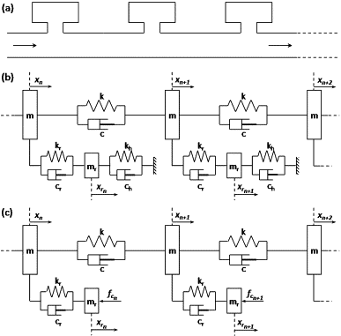
Metamaterial design
Based on an acoustic duct with Helmholtz resonators
Capable of achieving single negative behaviour – Negative effective mass (M_{e}) due to locally resonant elements
‘Earth’ connections of the Helmholtz resonators are replaced with active feedback forces
Pope and Daley, 2011

Slide 5

Employing active control strategies
Pope and Daley, 2011

Slide 6
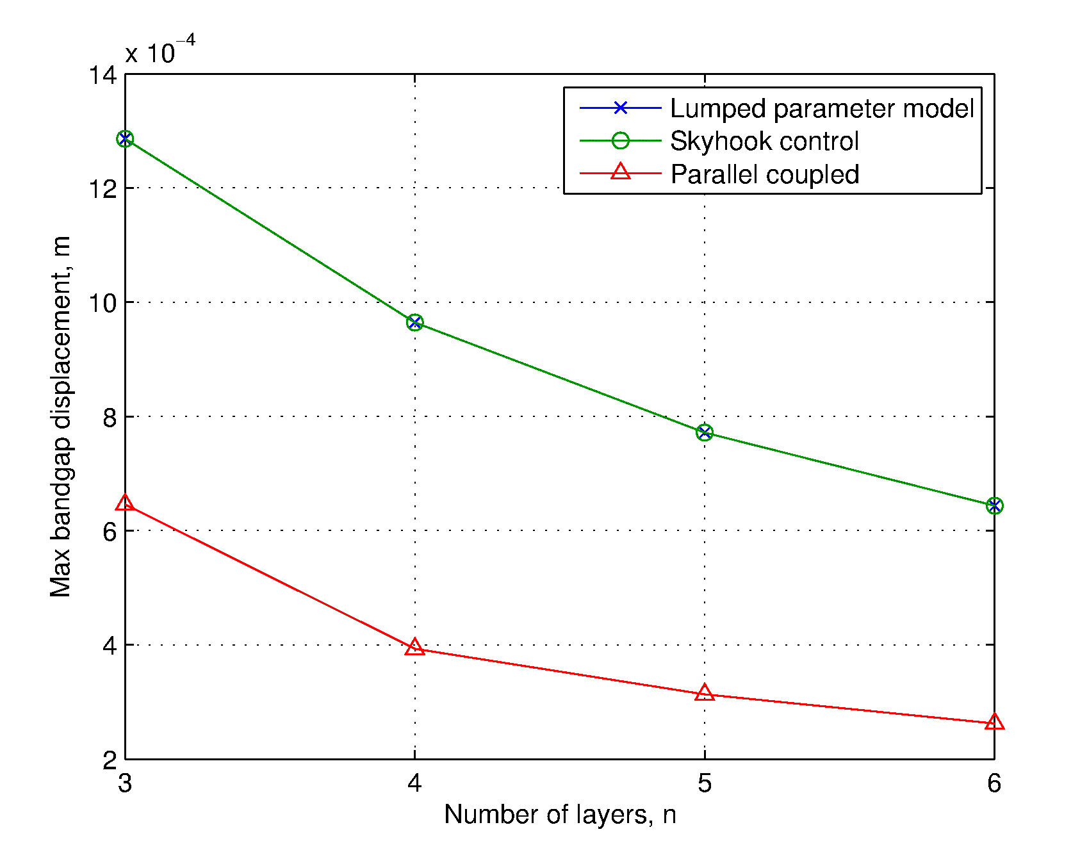
Displacement of material elements
A 4 layer material with a 10mm diameter circular cross section, incident with 90dB SPL acoustic wave (ref 20x10⁻⁶Pa). Material properties described in paper.
Maximum displacement of elements around the low frequency resonant band gap is in the order of 1mm
4 layer material, maximum displacement of elements
Blue ‘o’: Passive. Black ‘x’ : Active SH. Red dotted: Active PC
Maximum displacement is reduced with additional layers
Displacement appears to tend to finite value
Passive and SH models show max. displacement in first transmission mass
PC model alternates between first and last mass
Maximum displacement of elements vs No. of layers
Blue ‘o’: Passive. Black ‘x’ : Active SH. Red dotted: Active PC

Slide 7
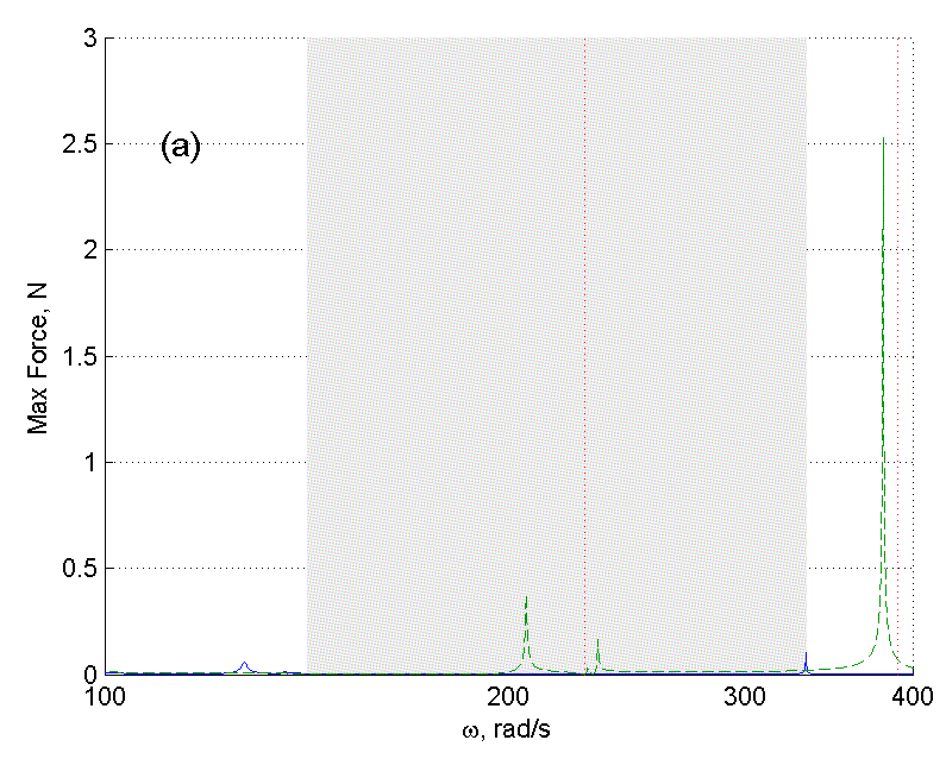
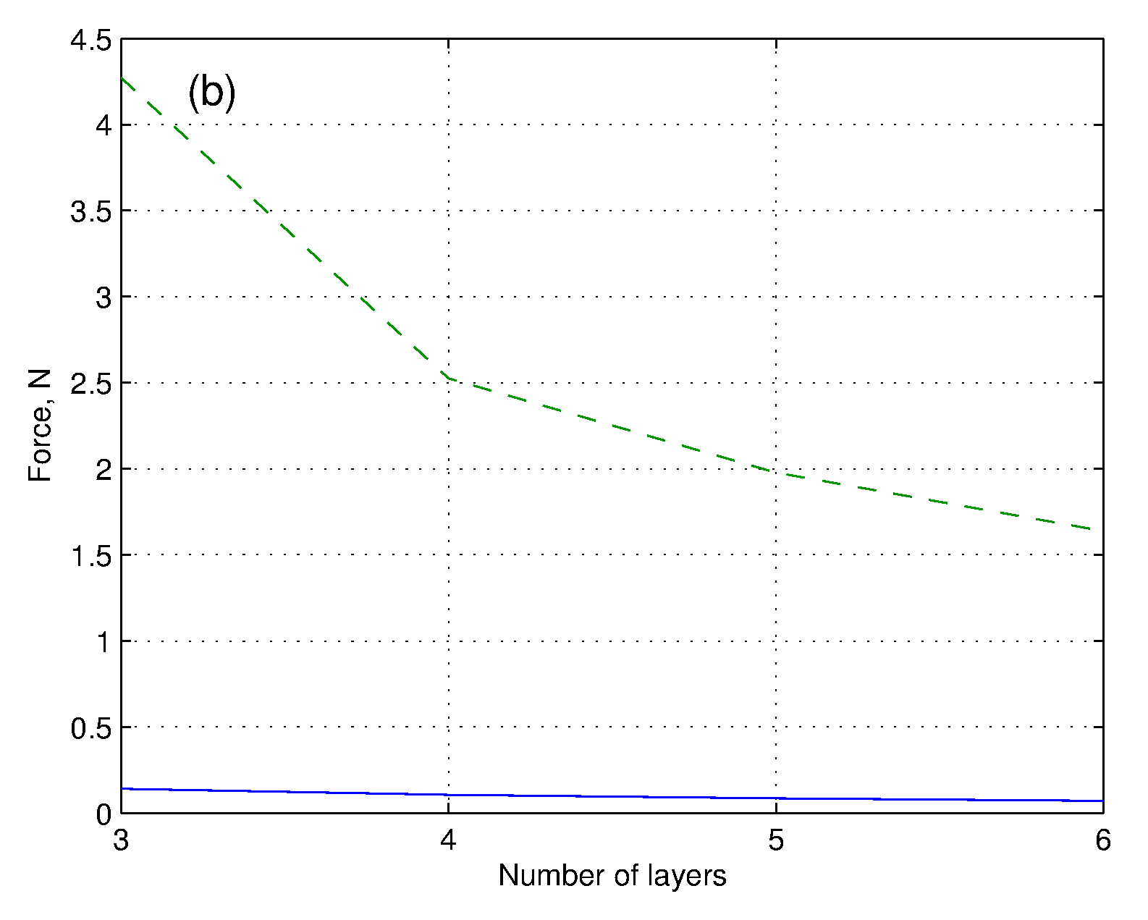
Magnitude of Control Forces
SH offers considerable advantages over PC when considering required force and transducer size
Differences between strategies over an order of magnitude
Maximum required control force within resonant band gap region for a 4 layer material
Green dotted: Parallel Coupling, Blue: Skyhook
Additional layers reduce the amount of required force
Tends towards a finite value
Maximum required control force within resonant band gap region vs No. of layers
Green dotted: Parallel Coupling, Blue: Skyhook

Slide 8
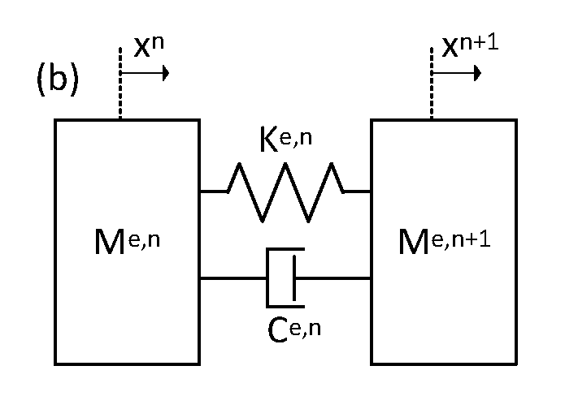





Isolation Performance
Metamaterial with low frequency, resonant band gap could be used as high performance vibration isolator
Performance can be assessed by representing the material as a simple viscoelastic material consisting of effective material parameters M_{e}, K_{e}, and C_{e}
$$\left\{\frac{f_{n+1}}{x_{n+1}}\right\}=\left[\begin{matrix}T_{n,\left(1,1\right)} & T_{n,\left(1,2\right)} \\ T_{n,\left(2,1\right)} & T_{n,\left(2,2\right)}\end{matrix}\right]\left\{\frac{f_{n}}{x_{n}}\right\}$$
$$\left\{\begin{matrix}f_{n+1} \\ x_{n+1}\end{matrix}\right\}= \left(\frac{−ω^{2}M_{e}+iωC_{e}+K_{e}}{iωC_{e}+K_{e}}\right)\left[\begin{matrix}\frac{iωC_{e}+K_{e}}{−ω^{2}M_{e}+iωC_{e}+K_{e}} & \frac{−ωM_{e}(iωC_{e}+K_{e})}{−ω^{2}M_{e}+iωC_{e}+K_{e}} \\ \frac{1}{iωC_{e}+K_{e}} & 1\end{matrix}\right]\left\{\begin{matrix}f_{n} \\ x_{n}\end{matrix}\right\}=\left(\frac{−ω^{2}M_{e}+iωC_{e}+K_{e}}{iωC_{e}+K_{e}}\right)\left[Γ\right]\left\{\begin{matrix}f_{n} \\ x_{n}\end{matrix}\right\}$$
$${(f}_{N}=0)0$$

Slide 9

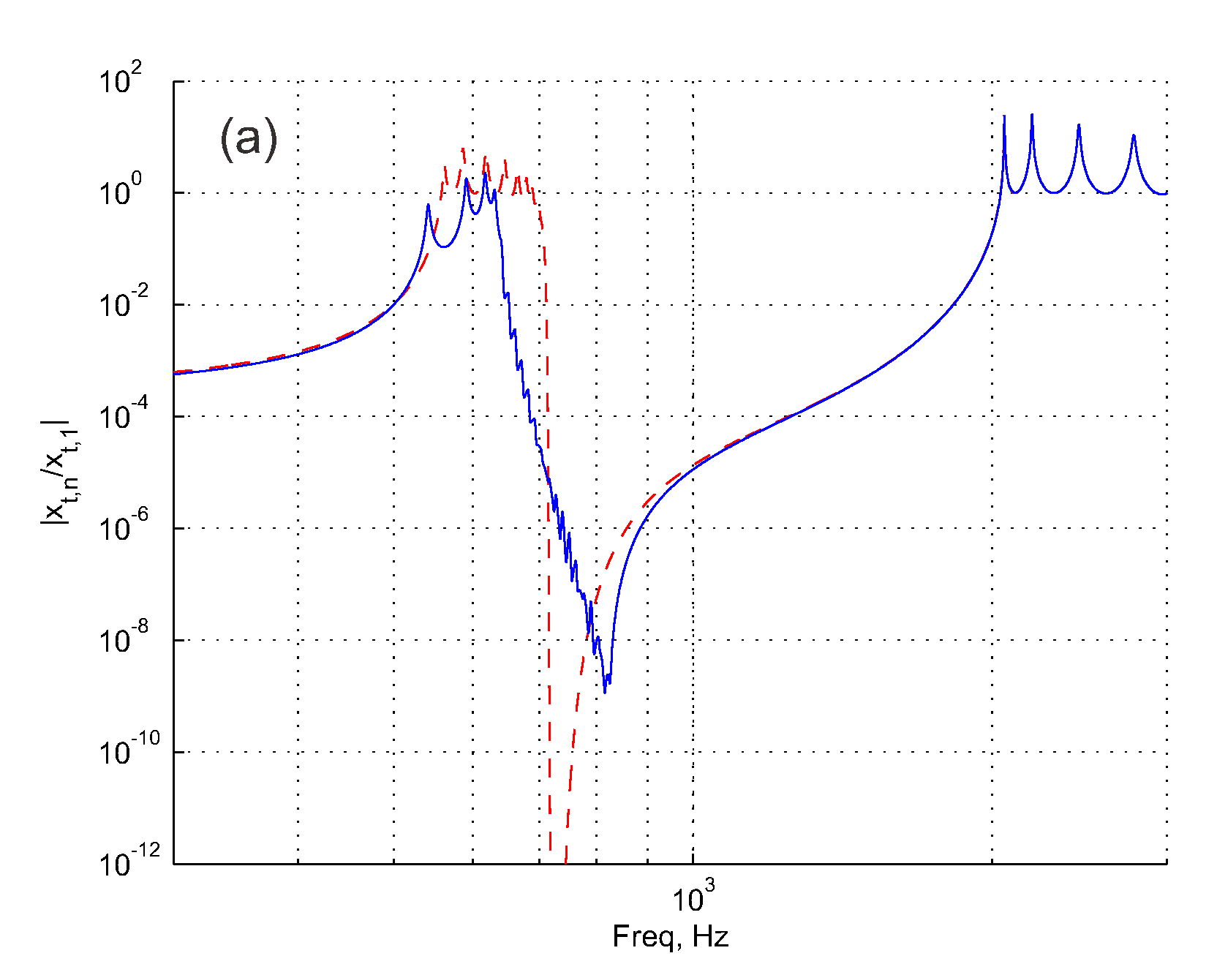
Widening the resonant band gap in Skyhook materials
Adapt feedback force layer to layer to change the frequency that the resonant elements operate at
Altering displacement feedback control gain k_{c,} physically equivalent to changing the resonator stiffness k_{h} in the passive model
Hence, stagger the zeros associated with the resonator so they do not occur at the same frequency, widening the band gap
Low frequency band gap response of multiple layer metamaterial
Red dotted: identical resonators
Blue line: staggered resonators

Slide 10
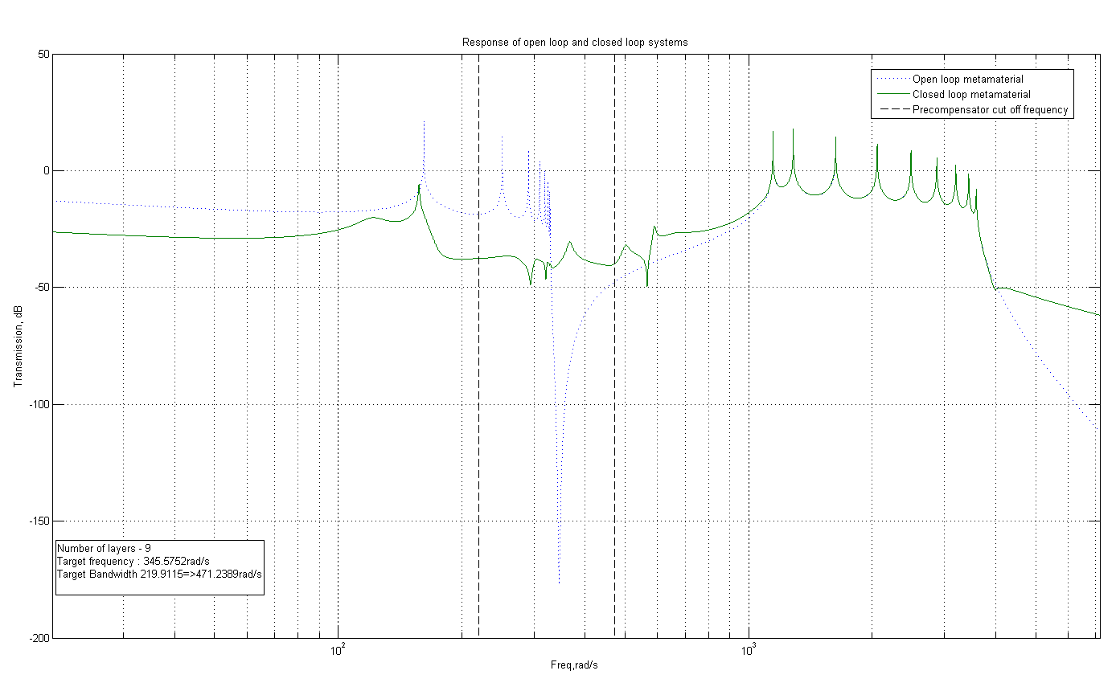
Optimisation of band gap control force
Trade off exists between band gap width and depth.
Resonant peaks occurs before dip in resonator response, limiting the performance of staggered resonators
Currently attempting to apply established control optimisation techniques to design control forces such as to achieve optimal band gap performance

Slide 11
Conclusions
An active metamaterial was designed to emulate a passive equivalent
Architecture extended to provide double negativity
Displacement of elements and active forces required will limit the dimensions of a practical material
Control forces can be adapted to widen the low frequency band gap for use as a vibration isolator
On going work involving optimising the control force for maximum band gap performance

