Slide 2
Hutchinson group

Slide 3

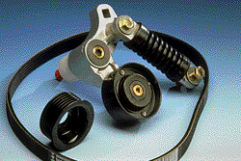
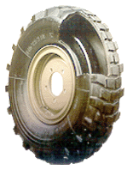
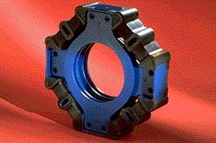
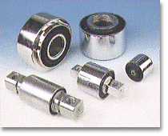
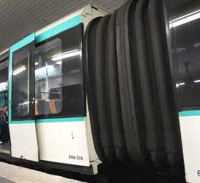
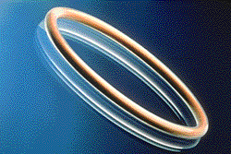
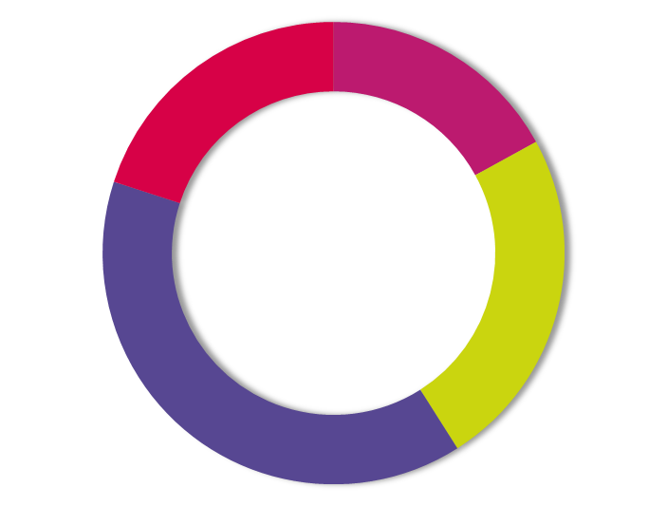
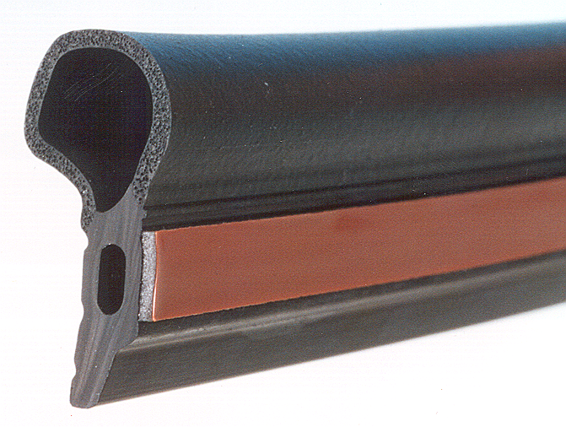
Hutchinson: activities
International leadership of industrial rubber
Sales Figure: €2,720M
Automotive
Heavy truck
All industry
Defense
Aerospace
Railroad
23%
12%
Fluid Transfer systems
Transmission and Mobility
24%
41%
Insulation
Sealing Systems
Notes:
25448 collaborateurs

Slide 4



Hutchinson group
More than 100 worldwide production sites
More than 20 technical centers
1 corporate research center (Montargis, France)

Slide 5
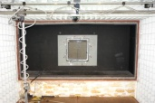


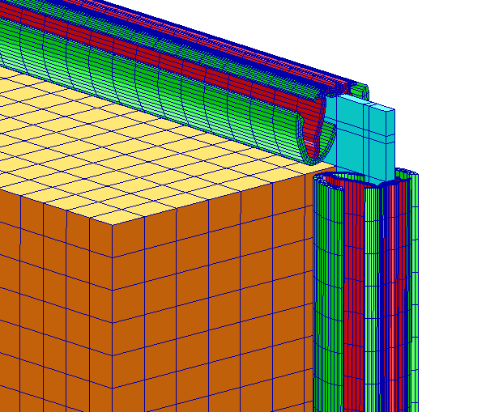
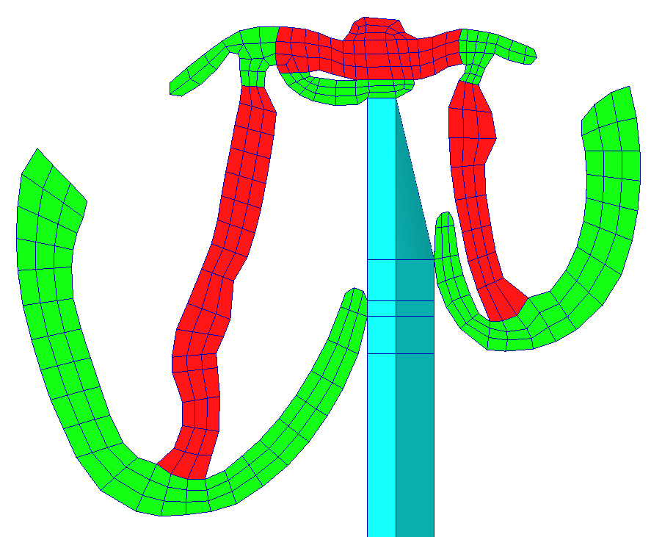
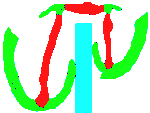
Measurements at Hutchinson R&D
Measurement/simulation comparison
Vibro-acoustic system modeling
How to improve acoustic performance of automotive lateral windows
Parametric studies
Product improvement, ranking of solutions

Slide 6
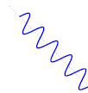
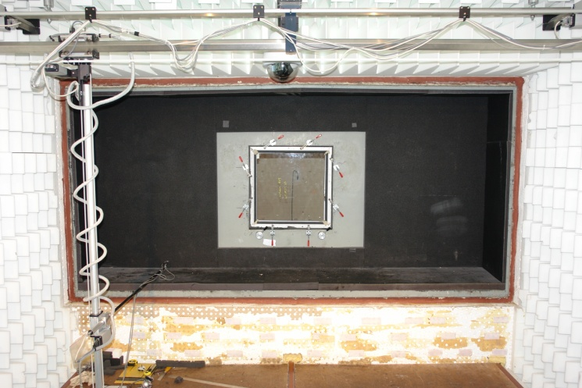
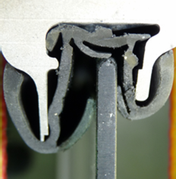
Acoustic transparency measurement procedure
Critical frequency
Mass law

Slide 7
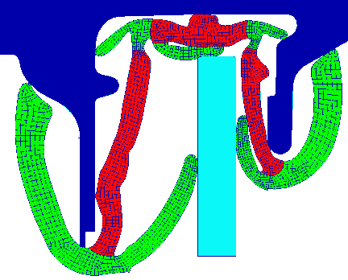
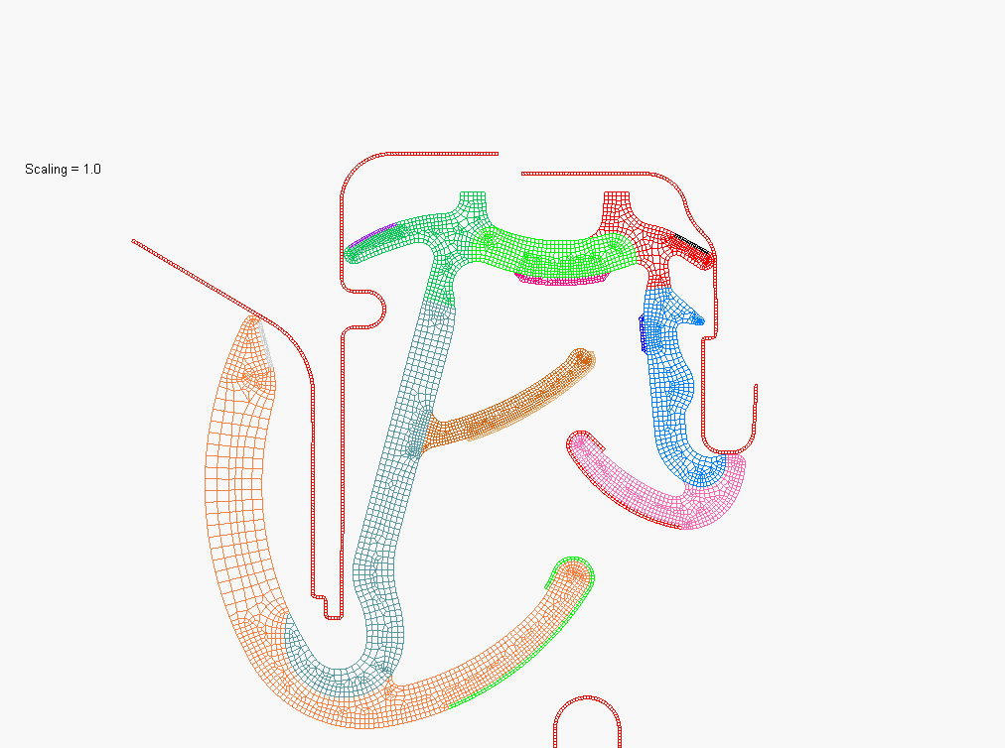
Structure model
Structural non linear 2D model (static analysis)
600×600 mm² plate glass
2-material glass run channel (2.2m long)
Aluminum frame (rigid)
Structural analysis

Slide 8
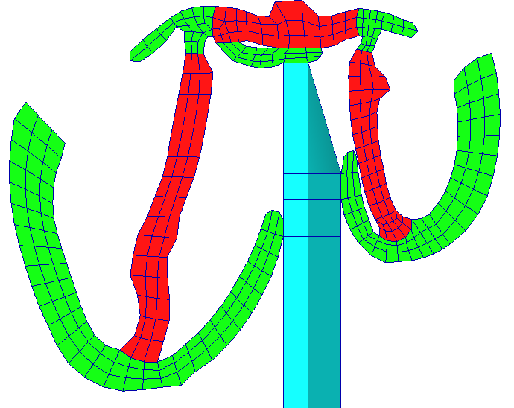
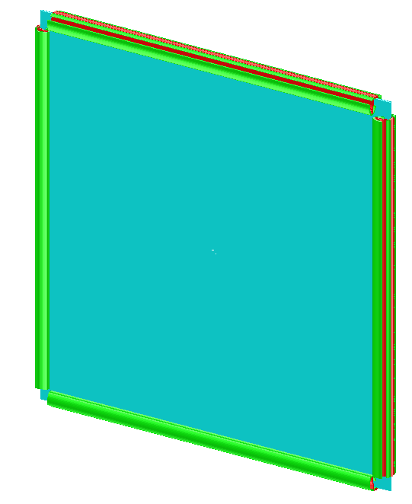
Coupled model
Structural 3D model (dynamic analysis)
Baffled
Incident space : Rayleigh
Transmitted space : infinite FEM
600×600 mm² plate glass
2-material glass run channel (2.2m long)
Vibro-acoustic model
glass run channel
glass
incident
power
transmitted
power
air (I-FEM)
Simulation by MSC/Actran

Slide 9
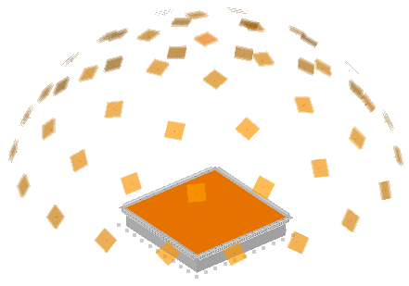
Acoustic excitation
Diffuse field :
- same probability for every directions of plane waves
incidence (θ) | number of azimuthal waves (ϕ) | weighting of wave
0 | 1 | 0.2704
17.5 | 6 | 0.3095
35 | 10 | 0.3311
52.5 | 15 | 0.3180
70 | 18 | 0.3159
Total waves | 50
z
θ
φ
y
x

Slide 10
Transmission Loss per incident waves
Diffuse field :
- same probability for every directions of place waves
Real life measurement :
- truncation of some waves (wall proximity)
Glass thickness of 3,85 mm
Truncation of waves gives higher TL

Slide 11
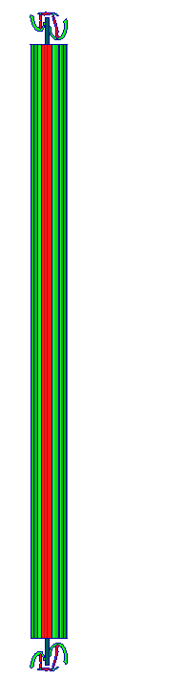
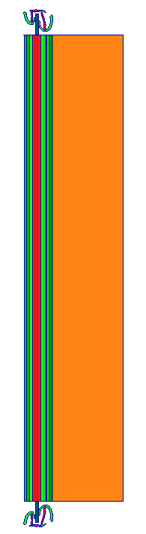
Transmitted power evaluation
W_{tr}
Glass thickness of 3,85 mm
Measurement of the transmitted acoustic power at 10cm from glass gives higher TL and critical frequency.

Slide 12
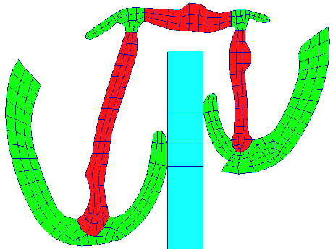
Effect of glass thickness
e
TL is increased in LF as thickness is increased.
Critical frequency LF shift with thickness increase.
Higher TL at critical frequency for large thickness.

Slide 13
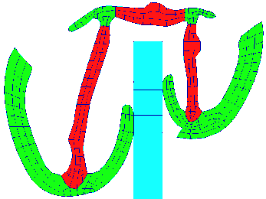
Effect of glass run channel design
2 lips
Glass thickness of 3,85 mm
3 lips
Effect at critical frequenncy
Ranking of glass run channel design

Slide 14
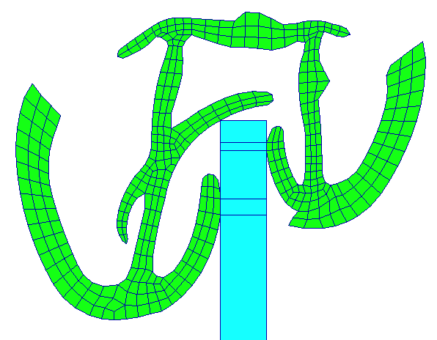



Product improvement
Several design proposals simulated
Épaisseur de vitrage de 3,85 mm
most effective design
→ Ranking of design proposal by simulation

Slide 15
fine 3D mesh
Representative excitation
Computing of the transmitted power at the right location
Validated and reliable model that are used for:
  sensitivity studies on parameters such as thickness of the glass, design of the glass run channel
  comparison and ranking of different designs by simulation, allows less prototypes and tests

